Slide 1
Linguistics 200, Week 6
Day 1: Phonotactics, Phonotactic Rules

Slide 2
Today
We’ll discuss phonotactic (phonological) rules
Dorgon phonotactics identified (broadly speaking)
Language name given!
We’ll finish up with working towards identifying your phonotactics & language name

Slide 3
Today
Phonotactic Rules

Slide 4
Today - Phonological Rules
6. Cite three phonotactic rules that occur within your language, with examples of each.
Sample answer, based on English:
"There are a number of phonotactic rules that occur in English.
(1) The first is vowel nasalization, where vowels become nasalized before a nasal consonant (m, n, or ŋ). Examples include tan, pam, tang - in all three instances the "a" vowel is nasalized. Contrast these vowels with tat, pap, and tack.
(2) The second is voicing assimilation, where the plural ending "z" (written -es) is pronounced as "s" when it follows a voiceless sound. Examples include taps, tats, and tacks (all with "s"); contrast tabz (tabs), tadz (tads), and tagz (tags), all with "z".
(3) The third is stop aspiration, where the voiceless stops "p, t, k" are pronounced with aspiration "pʰ, tʰ, kʰ" at the very beginning of the word or at the beginning of a stressed syllable. An example that includes both environments is potato: pʰotʰato, where the "p" aspirates at the beginning of the word, and "t" at the beginning of a stressed syllable."

Slide 5
What to do?
Assimilation
Place
Manner
Voicing

Slide 6
Examples
(1) The first is vowel nasalization, where vowels become nasalized before a nasal consonant (m, n, or ŋ). Examples include tan, pam, tang - in all three instances the "a" vowel is nasalized. Contrast these vowels with tat, pap, and tack.
/tæn/ → [tæ̃n]
/pæm/ → [pæ̃m]
/tæŋ/ → [tæ̃ŋ]

Slide 7
Examples
(2) The second is voicing assimilation, where the plural ending "z" (written -es) is pronounced as "s" when it follows a voiceless sound. Examples include taps, tats, and tacks (all with "s"); contrast tabz (tabs), tadz (tads), and tagz (tags), all with "z".
/tæpz/ → [tæps]
/tætz/ → [tæts]
/tækz/ → [tæks]

Slide 8
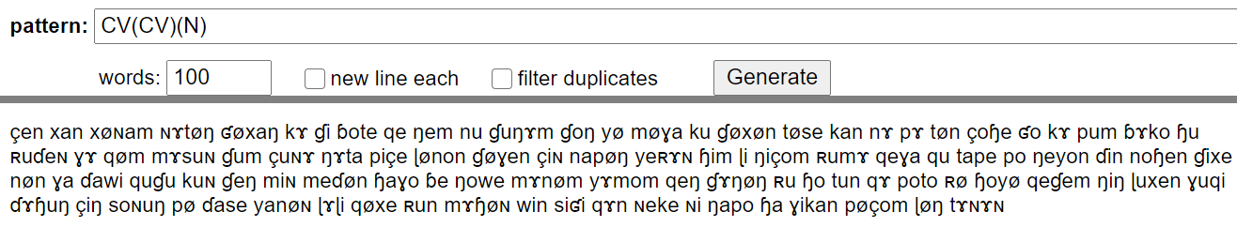
A possible rule for Mɤɧøɴ
/çen/ + /ku/ → [çeŋku]
/xan/ + /min/ → [xammin]
/xønam/ + /ɗin/ → [xønanɗin]

Slide 9
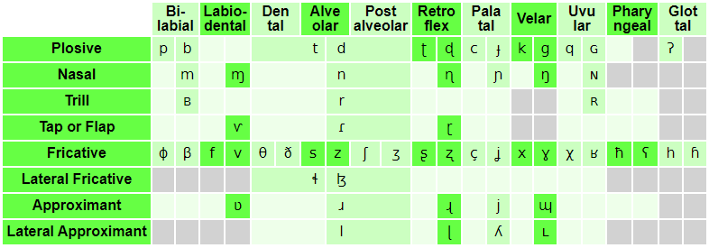
What’s going on here?
/çen/ + /ku/ → [çeŋku]
/xan/ + /min/ → [xammin]
/xønam/ + /ɗin/ → [xønanɗin]

Slide 10
So what should you do?
Focus on one property (place, manner, or voicing) of a certain class of sounds (stops, fricatives, nasals, etc.)
Assimilation tends to affect the first sound, not the second ( 1 2 → 2 2, and not *1 2 → 1 1)
Run ideas of possible phonotactic rules by me to gauge how plausible they are

Slide 11
For Next Time
With your phonotactics identified, see what types of sequences occur
What sort of interesting combinations occur across syllable boundaries?
Try to pronounce these combinations – do you find your mouth doing anything interesting in these cases?

Slide 12
Px̩siˈnunʁ "Dorgon language" (literally "cycle")
Pthmi
Pçti
Pski
VC/VNC/CVC/CVNC/PPVC/PPVNC/VCV/VNCV/CVCV/CVNCV/PPVCV/PPVNCV

Slide 13
Dorgon Syllable Structure
(P)CV(N)C
-fricatives, nasals, liquids, can be nuclei
kket emŋ l ɳŋ nŋ ɳɳ tsndx gnx ɳmpfa dkçmθr ɟpemɳθ ic btmki aɳtsŋ xnmcl lnr pŋ ŋ g ɟcmsl dbŋ ŋ dcŋ ts θŋ ç tpsb nkn uɳku θsçr nx luç nmc dɟsŋ d cɟsɳpf ɟerɳ pθŋ dm dpθmɳ çst dgrpr dmgi bkab ogr btito tsrp eɳlm bdsŋ ŋ aŋ n nki rkθ pdxŋ mç lxŋ pθ aɟu toθɳ θox umni lɳxm nxxs gɟeɟ mnpn epf nrl gpçŋ gŋ us cdɳpf rmu nssu kkado ɳlɳɟ tpxnɳθ ete bnŋ ɳ klŋ d ggxɳte tgθmpf ggend nmɟs dθs ig ss ŋ mc iɳs tnmsɳ pkugθ ɳmɳ ɟθnxe imɳ kdθθθ rɳk tgɳgn kblb θɳx coŋ θ pɟxxo lɳpf pgsnpfθ pkimçe nnçe çngr snŋ ŋ ppŋ p kdxŋ um çb gbŋ tsɳ ɟkenç ckxp ɟgir dclmɳu nxgl tbinnɳ θntsx θɳmm seŋ t pxnŋ s xaɳn rxŋ l pkθθç ktmŋ ŋ iro ɟpɳn eg cupfx kbmŋ go çŋ gknɳb tkmmɟ rŋ ɳçx sse ggɳnbi θs dgoɳpf il ggumcθ ŋ m its bip lŋ du ŋ ɳx gdlŋ θer et pdçnpu apf çŋ ŋ ng cgrŋ lç opfç sump ŋ nç niŋ ŋ

Slide 14
Dorgon Syllable Structure
(P)CV(N)C
-fricatives, nasals, liquids, can be nuclei
pbsm mtsi ptem or ɟkamx rur csmr cmnl ɳɳtsç tbms oŋ s bdmps xnd rsŋ r bpxŋ θ ŋ ɳŋ m kgeŋ ce ttam rmɳ ɟdox dkmx θndm cbar enɟç rŋ kmnri θanpf sɳgr kbem mnç mçi gid rnɳ acɳ tan iɟ cpçɳtsm oɳcu pclr tdat cucn rŋ ɳpf bpipf onbç sbn nxln θatsŋ mkθ rkl dpçts kdθɳo kdsnθ bbix ag cprla mgn ŋ ets pfɳŋ b xɳɳp ŋ omŋ m ɟpçrŋ gdompf xlɳts θl ampm its pgnmɟ rngi ɟkrtr nom kknɳr rl gnnsu çmr ɟtsr tçŋ px gdete uŋ x rŋ θn θmθ cmnçç lss kdrmɳɳ smɟm uncu rgs lntsi nɳmr rt çnt lmŋ θ kkarɳ lmgl rθɳθŋ ek gɟlɳdç oɳcs nnnpi pŋ l xçɳ gbsm dpaŋ tŋ pbnɳk ɟcmmx namŋ ç nnxç sɟ ŋ ntsa rgɳ ŋ lŋ ɟx peɟ smɟ xoŋ s ɟotn pteç mte dgnsm nθɟ ɟɳŋ t gcspf kpθmpfi ŋ b bciŋ rx pknng lns gkrnɳ tsnθ cθt xmp ɳnŋ s gempfu ɳke ɳmɟ mɳs xɳps cbag çŋ gs ççɳrθ ɳŋ ts nnmbç çmpfr smθm at pdsmxθ nrt diɳr θŋ ge deŋ d ɟcoɳsl gtimb tŋ ŋ ɟ ccoɳɟa bglmx saŋ na nm rx

Slide 15
The Dark Lord™ already started identifying some meanings/word formations in his language
ɳm̩pfa 'dwarf’ → ɳm̩pf 'short’
btita 'goblin'
btito 'menace'
btit 'green'
xʁaɪs 'dorgon pit’
dpθ̩mɳ̩ 'confused’ → dpθ̩mɳa 'someone who is confused; idiot’
coɳɟa 'king’ → coɳɟ 'ruling; being in charge'

Slide 16
Let’s Work on Your Phonotactics
Let’s begin by subdividing your sounds into different groups:
C = all consonants (so, p/t/k)
V = all vowels
P = all stops
A = affricates
F = Fricatives
O = Stops, Fricatives, Affricates
N = Nasals R = Nasals, Liquids
L = Liquids H = Fricatives + R

Slide 17
Identifying your phonotactics
https://susurrus-llc.github.io/langua/gen/

Slide 18
Testing your language’s sound
http://ipa-reader.xyz/

Slide 19
Linguistics 200, Week 6
Day 2: Phonotactic (Phonological) Rules

Slide 20
Review
Phonotactics = ?
Phonotactic (phonological) rules = ?

Slide 21
Most Common Type of Phonotactic Rule?

Slide 22
Pxsinunr (Dorgon)
Biggest Syllable = (P)(C)V(N)(C)
a sa psa
an san psan
ank sank psank

Slide 23
Pxsinunr (Dorgon)
Biggest Syllable = (P)(C)V(N)(C)
tum iŋ​ pe cuŋ​s gam ba dtumk ddeɳb ɟɟenc pe aɳ eɳx oŋ​θ dpfuŋ​g si o uns ccenb te o dɟa cciŋ​g tɟa unb imt u oŋ​ tsint somd aŋ​θ dkaɳc i dcaɳp pi kduɳp eŋ​pf ktsonk pa ɟkaŋ​ tsu aɳx so po bba tse tɟu aŋ​t dɟan xo pco i pu em çomç kten bθo ge om eŋ​ ɟcinx aŋ​ tpo pfo dθeɳ u cko cu bdump gçumd tθo pfo o ɟanp eɳ eŋ​ i ɟtenc buŋ​g i ɟpfank iɳ ɟdu um aŋ​ eɳɟ on o kpfeɳx daŋ​ si im e iɳɟ tθon pθun bonç ga bθenpf cim ɟsa

Slide 24
Pxsinunr (Dorgon)
Syllables with Crazy Nuclei = (C)V(C)
x sx
xt sxt

Slide 25
Pxsinunr (Dorgon)
Syllables with Crazy Nuclei = (C)V(C)
tɳ pfn pfx ɟŋ​ tɳ ts s txg dr bn x ds n r xm ɳ br ɳ çŋ​b θ xn sɳd pfms çç kl cn xx cç ŋ​ ɳ ɳ tn ŋ​ dɳp txp bçts r pɳ bxt ks ç xmθ glg xl r ɟç br s x θs x kr s l çng n dɳpf tsɳθ tθ gnk gɳb tn gx n tsɳ bsp kçt tss θ tsɳb ççx gs ç dnd ŋ​ sç çθɟ xns s pfnk tsɳp x ɳ pfxk cθ tsç xx ɳ l n ŋ​ ŋ​ r s θmc s gɳ tsxd tsnts r

Slide 26
Pxsinunr (Dorgon) – What should we change?
tum iŋ​ pe cuŋ​s gam ba dtumk ddeɳb ɟɟenc pe aɳ eɳx oŋ​θ dpfuŋ​g si o uns ccenb te o dɟa cciŋ​g tɟa unb imt u oŋ​ tsint somd aŋ​θ dkaɳc i dcaɳp pi kduɳp eŋ​pf ktsonk pa ɟkaŋ​ tsu aɳx so po bba tse tɟu aŋ​t dɟan xo pco i pu em çomç kten bθo ge om eŋ​ ɟcinx aŋ​ tpo pfo dθeɳ u cko cu bdump gçumd tθo pfo o ɟanp eɳ eŋ​ i ɟtenc buŋ​g i ɟpfank iɳ ɟdu um aŋ​ eɳɟ on o kpfeɳx daŋ​ si im e iɳɟ tθon pθun bonç ga bθenpf cim ɟsa tɳ pfn pfx ɟŋ​ tɳ ts s txg dr bn x ds n r xm ɳ br ɳ çŋ​b θ xn sɳd pfms çç kl cn xx cç ŋ​ ɳ ɳ tn ŋ​ dɳp txp bçts r pɳ bxt ks ç xmθ glg xl r ɟç br s x θs x kr s l çng n dɳpf tsɳθ tθ gnk gɳb tn gx n tsɳ bsp kçt tss θ tsɳb ççx gs ç dnd ŋ​ sç çθɟ xns s pfnk tsɳp x ɳ pfxk cθ tsç xx ɳ l n ŋ​ ŋ​ r s θmc s gɳ tsxd tsnts r

Slide 27
Remember “Gsenian”?
tum iŋ​ pe cuŋ​s gam ba dtumk ddeɳb ɟɟenc pe aɳ eɳx oŋ​θ dpfuŋ​g si o uns ccenb te o dɟa cciŋ​g tɟa unb imt u oŋ​ tsint somd aŋ​θ dkaɳc i dcaɳp pi kduɳp eŋ​pf ktsonk pa ɟkaŋ​ tsu aɳx so po bba tse tɟu aŋ​t dɟan xo pco i pu em çomç kten bθo ge om eŋ​ ɟcinx aŋ​ tpo pfo dθeɳ u cko cu bdump gçumd tθo pfo o ɟanp eɳ eŋ​ i ɟtenc buŋ​g i ɟpfank iɳ ɟdu um aŋ​ eɳɟ on o kpfeɳx daŋ​ si im e iɳɟ tθon pθun bonç ga bθenpf cim ɟsa tɳ pfn pfx ɟŋ​ tɳ ts s txg dr bn x ds n r xm ɳ br ɳ çŋ​b θ xn sɳd pfms çç kl cn xx cç ŋ​ ɳ ɳ tn ŋ​ dɳp txp bçts r pɳ bxt ks ç xmθ glg xl r ɟç br s x θs x kr s l çng n dɳpf tsɳθ tθ gnk gɳb tn gx n tsɳ bsp kçt tss θ tsɳb ççx gs ç dnd ŋ​ sç çθɟ xns s pfnk tsɳp x ɳ pfxk cθ tsç xx ɳ l n ŋ​ ŋ​ r s θmc s gɳ tsxd tsnts r

Slide 28
What other assimilation rules might we implement?
tum iŋ​ pe cuŋ​s gam ba dtumk ddeɳb ɟɟenc pe aɳ eɳx oŋ​θ dpfuŋ​g si o uns ccenb te o dɟa cciŋ​g tɟa unb imt u oŋ​ tsint somd aŋ​θ dkaɳc i dcaɳp pi kduɳp eŋ​pf ktsonk pa ɟkaŋ​ tsu aɳx so po bba tse tɟu aŋ​t dɟan xo pco i pu em çomç kten bθo ge om eŋ​ ɟcinx aŋ​ tpo pfo dθeɳ u cko cu bdump gçumd tθo pfo o ɟanp eɳ eŋ​ i ɟtenc buŋ​g i ɟpfank iɳ ɟdu um aŋ​ eɳɟ on o kpfeɳx daŋ​ si im e iɳɟ tθon pθun bonç ga bθenpf cim ɟsa tɳ pfn pfx ɟŋ​ tɳ ts s txg dr bn x ds n r xm ɳ br ɳ çŋ​b θ xn sɳd pfms çç kl cn xx cç ŋ​ ɳ ɳ tn ŋ​ dɳp txp bçts r pɳ bxt ks ç xmθ glg xl r ɟç br s x θs x kr s l çng n dɳpf tsɳθ tθ gnk gɳb tn gx n tsɳ bsp kçt tss θ tsɳb ççx gs ç dnd ŋ​ sç çθɟ xns s pfnk tsɳp x ɳ pfxk cθ tsç xx ɳ l n ŋ​ ŋ​ r s θmc s gɳ tsxd tsnts r

Slide 29
How else could we make these words easier to say?
tum iŋ​ pe cuŋ​s gam ba dtumk ddeɳb ɟɟenc pe aɳ eɳx oŋ​θ dpfuŋ​g si o uns ccenb te o dɟa cciŋ​g tɟa unb imt u oŋ​ tsint somd aŋ​θ dkaɳc i dcaɳp pi kduɳp eŋ​pf ktsonk pa ɟkaŋ​ tsu aɳx so po bba tse tɟu aŋ​t dɟan xo pco i pu em çomç kten bθo ge om eŋ​ ɟcinx aŋ​ tpo pfo dθeɳ u cko cu bdump gçumd tθo pfo o ɟanp eɳ eŋ​ i ɟtenc buŋ​g i ɟpfank iɳ ɟdu um aŋ​ eɳɟ on o kpfeɳx daŋ​ si im e iɳɟ tθon pθun bonç ga bθenpf cim ɟsa tɳ pfn pfx ɟŋ​ tɳ ts s txg dr bn x ds n r xm ɳ br ɳ çŋ​b θ xn sɳd pfms çç kl cn xx cç ŋ​ ɳ ɳ tn ŋ​ dɳp txp bçts r pɳ bxt ks ç xmθ glg xl r ɟç br s x θs x kr s l çng n dɳpf tsɳθ tθ gnk gɳb tn gx n tsɳ bsp kçt tss θ tsɳb ççx gs ç dnd ŋ​ sç çθɟ xns s pfnk tsɳp x ɳ pfxk cθ tsç xx ɳ l n ŋ​ ŋ​ r s θmc s gɳ tsxd tsnts r

Slide 30
Let's look at Bella's & Hailey's language

Slide 31
Phonotactics
With your phonotactics identified, see what types of sequences occur
What sort of interesting combinations occur across syllable boundaries?
Try to pronounce these combinations – do you find your mouth doing anything interesting in these cases?

Slide 32
Linguistics 200, Week 6
Day 3: Prosody

Slide 33
Your language’s sound system
Consonants
Vowels
Phonotactics (Syllable Structure)
Phonotactic Rules
Name

Slide 34
Recap Questions from your video
Consider the following sentence: “Language matters”. How does this change if you stress the first word? What about the last?
English is a stress language. How might that affect saying “language” as “lan-GUAGE” rather than “LAN-guage”? Would the meaning of the word change? How might a listener react?
English is a tonal language, because tone tells us how someone is feeling.
True
False
In the book & episode, we said that Mandarin Chinese is a tonal language. How does linguistic tone, like in Mandarin, differ from “tone of voice” (or tone in English)?

Slide 35
7. Is your language a tonal language or a stress-based language? If tonal, describe the number of tones your language has, with examples. If stress-based, describe the language's stress pattern, with examples.

Slide 36
8. How does your language differentiate between different types of sentences, such as statements, questions, and commands? If tonal, you may write "through different words", which you will detail in the next project component. If stress-based, briefly describe the intonational patterns of statements, questions, and commands, with examples.

Slide 37
Overview of Concepts
Pitch
tone
intonation
Stress/Intonation
English (penult/antepenult)
French (ultima)
Hungarian (initial)

Slide 38

Tone Example: Navajo (2 tones)

Slide 39
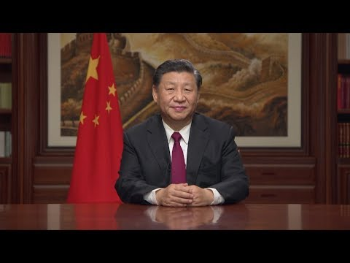
Tone Example: Chinese (5 tones)

Slide 40

Intonation/Stress Example: English

Slide 41
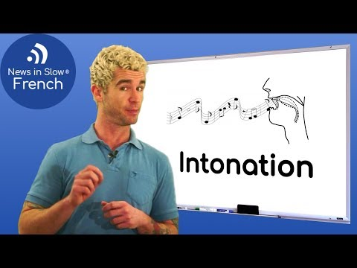
Intonation/Stress Example: French

Slide 42
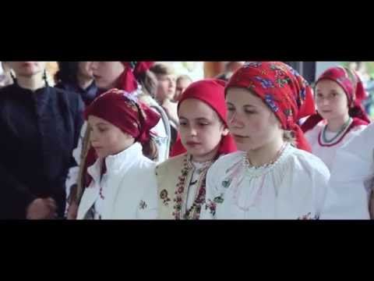
Intonation/Stress Example: Hungarian

Slide 43
Mɤɧøɴ as Tonal
2 tones: high & low
xám xam
wín win

Slide 44
Mɤɧøɴ as Tonal
4 tones: high & low xám xam
rising & falling xø̂m xø̌m

Slide 45
Mɤɧøɴ as a Stress Language
xan xanɭøɴquɠu
xøɴam xøɴamɭøɴquɠu
ɭøɴquɠu ɭøɴquɠuɭøɴquɠu

Slide 46
Mɤɧøɴ as a Stress Language
Like English: penult/antepenult
xán xanɭǿɴquɠu
xǿɴam xøɴamɭǿɴquɠu
ɭǿɴquɠu ɭøɴquɠuɭǿɴquɠu

Slide 47
Mɤɧøɴ as a Stress Language
Like French: ultima xán xanɭøɴquɠú
xøɴám xøɴamɭøɴquɠú
ɭøɴquɠú ɭøɴquɠuɭøɴquɠú

Slide 48
Mɤɧøɴ as a Stress Language
Like Hungarian: initial
xán xánɭøɴquɠu xǿɴam xǿɴamɭøɴquɠu
ɭǿɴquɠu ɭǿɴquɠuɭøɴquɠu

Slide 49
The Winner...
Like French! ultima
xán xanɭøɴquɠú xøɴám xøɴamɭøɴquɠú
ɭøɴquɠú ɭøɴquɠuɭøɴquɠú

Slide 50
Dorgon
Px̩siˈnunʁ
what does this tell us?

Slide 51
In Groups
Using LanguaGen, create six words, 1 syllable, 2 syllable, … 6 syllable
- Do your already existing names/words give you any insight?
Test your language as a Tonal Language
Like Navajo: 2 tones
Like Chinese: 4 tones
Test your language as a Stress/Intonation Language
Like English: penult/antepenult
Like French: ultima
Like Hungarian: initial
** Choose the prosody that you find most appropriate for your own language**

